Slide 1














Deep Learning with Multimodal Inputs for Enhanced Issue Resolution
Presented by :
Marina Reda 221101235
Omar adly 221101398
Hazem Ahmed 221100343
Ali sherif 221101562
Loay Gamal 221100419
Field -Program
CSE - AIS
Supervisor
Dr. Mohamed Ghetas
1

Slide 2
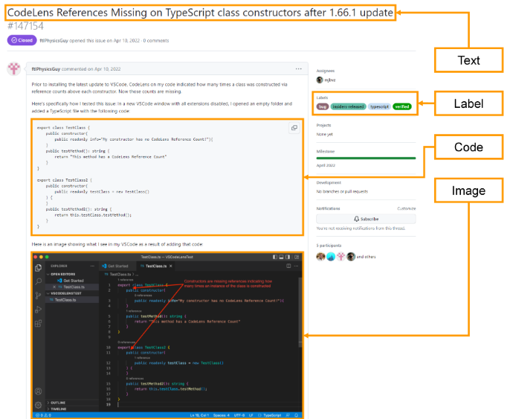
Introduction
Problem Context:
In open-source software development, GitHub's issue tracking system allows developers to report bugs and request features. These reports contain various types of data such as text, code, and images. Traditional classification models primarily use text, missing out on the full context provided by other data types.
Objective:
This project proposes FusionNet, a multimodal deep learning model that combines text, code, and image data to improve the classification of issue reports into bug or feature categories.
Goal:
Evaluate the performance of FusionNet across different data combinations (text, image, code) and demonstrate how leveraging multiple modalities enhances classification accuracy.
2

Slide 3
Related Work
Feature | Text-only Models | Multimodal Models
Data Used | Text only | Text, Image, and Code
Context Understanding | Limited to textual context | Leverages richer context with image and code
Accuracy | Often lower in complex tasks | Improved accuracy, especially in complex tasks
Examples | TF-IDF, RNNs | FusionNet, Multimodal CNNs
Text-Based Models:
Use only text data for classification.
Often limited by the inability to capture context from other modalities (images, code).
Examples: TF-IDF, RNNs for text classification.
Multimodal Models:
Combine multiple data sources: text, images, and code.
Improve classification accuracy by leveraging diverse information.
Examples: FusionNet (text + image + code), multimodal CNNs.
Advanced machine learning project _report.docx
3

Slide 4
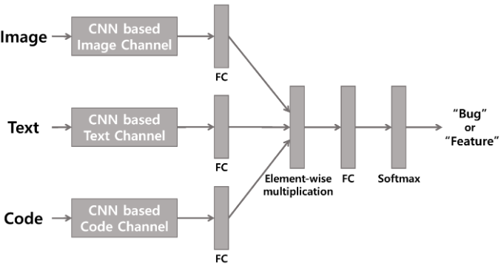
The Proposed Multimodal Approach
FusionNet is a deep learning framework designed for multimodal classification.
Integrates text, image, and code data for classifying software issue reports.
Aims to enhance issue report classification accuracy by combining multiple data sources.
Key Stages of FusionNet:
Data Pre-Processing: Text, image, and code inputs are pre-processed individually.
Feature Extraction: Pre-processed data are passed through CNN-based channels to generate feature vectors for each modality.
Fusion: Feature vectors from all modalities are integrated through element-wise multiplication to create a unified multimodal representation.
Classification: The fused representation is classified into "bug" or "feature" using a Softmax operation.
4

Slide 5
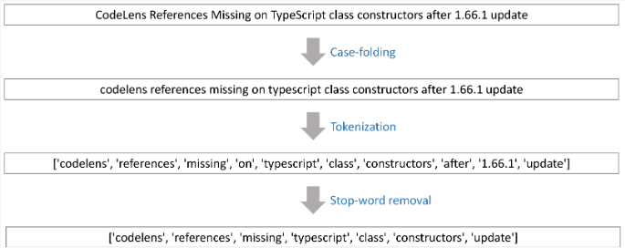

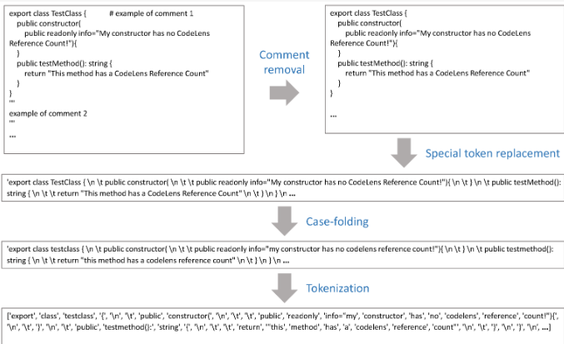
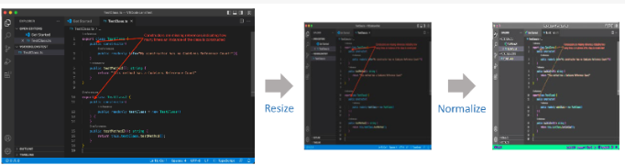
Text Pre-Processing:
Convert to lowercase (Case-Folding)
Tokenize text
Remove stop words and non-alphabetic tokens
Code Pre-Processing:
Remove comments
Replace special tokens (\n, \t)
Convert to lowercase
Tokenize code
Data Pre-Processing
Image Pre-Processing:
Resize to 258x258 pixels
Normalize pixel values to [-1, 1]
5

Slide 6
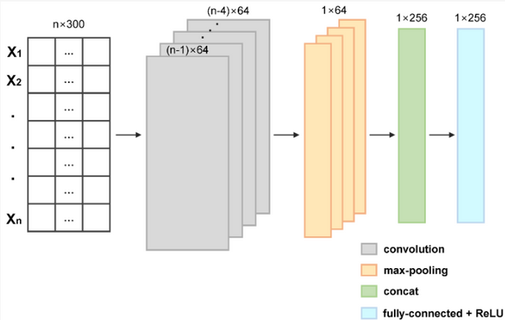
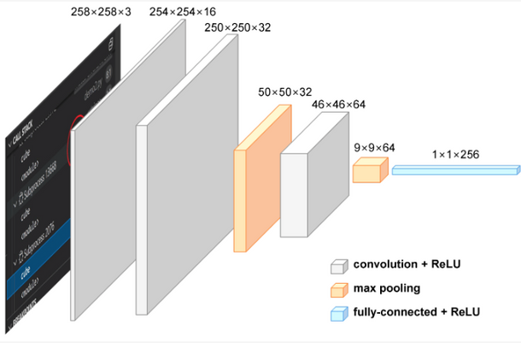
Text & Code Data
Embedding Layer: Converts data into vector representations.
CNN Processing: Applies convolution, max-pooling, and fully connected layers for feature extraction.
FEATURE EXTRACTION
Image Data
CNN Processing: Uses 3 convolution layers, max-pooling, and a fully connected layer to extract features.
6

Slide 7
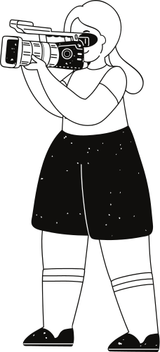
KEY STAGES OF FUSIONNET:
Fusion of Feature Vectors
Fusion Method: Combines features from different modalities (text, code, image) using element-wise multiplication.
Goal: Integrates data into a unified representation for better learning.
Benefit: Simplifies and enhances multimodal learning, making classification more accurate.
Classification into "Bug" or "Feature"
Final Step: Process the fused representation through a fully connected layer.
Softmax: Produces probabilities for classification into "Bug" or "Feature."
Optimization: CrossEntropyLoss is used for model optimization.
Scalability: Can be extended for multiclass classification tasks.
7

Slide 8
EXPERIMENTAL SETUP
Datasets:
Open-source projects from GitHub (VS Code, Kubernetes, Flutter, Roslyn).
Issues labeled as "Bug" or "Feature" for binary classification.
Data Sampling: Downsampling applied to balance class distribution (80:20 training/test split).
Models Compared:
Text Only Model: Baseline using only text data.
Multimodal Models:
FusionNet𝑇𝐼: Text and Image data.
FusionNet𝑇𝐶: Text and Code data.
FusionNet𝑇𝐼𝐶: Text, Image, and Code data.
Evaluation Metrics:
Precision, Recall, F1-score calculated for each class and averaged based on class distribution.
Project | Total Number of Issues | Label | Num
VS Code | 160,218 | Bug | 28,353
VS Code | 160,218 | Feature | 20,074
VS Code | 160,218 | Total | 48,427
Kubernetes | 115,035 | Bug | 13,059
Kubernetes | 115,035 | Feature | 5184
Kubernetes | 115,035 | Total | 18,243
Flutter | 118,576 | Bug | 13,037
Flutter | 118,576 | Feature | 9967
Flutter | 118,576 | Total | 23,004
Roslyn | 66,464 | Bug | 12,882
Roslyn | 66,464 | Feature | 3824
Roslyn | 66,464 | Total | 16,706
8

Slide 9
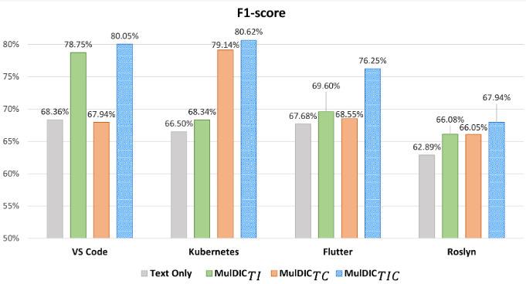
RESULT
Overall Findings:
FusionNet𝑇𝐼𝐶 (Text + Image + Code) outperformed other models across all evaluation metrics (Precision, Recall, F1-score).
The Text Only model was consistently outperformed by all multimodal models.
Key Experiments:
Text + Image (FusionNet𝑇𝐼):
Improved Precision (up to 11.15%), Recall (up to 9.65%), and F1-score (up to 10.39%) compared to the Text Only model.
Significant improvements seen in VS Code and Roslyn.
Text + Code (FusionNet𝑇𝐶):
Improved Precision (up to 13.06%) and F1-score (up to 12.64%), with VS Code showing slightly lower performance.
Text + Image + Code (FusionNet𝑇𝐼𝐶):
Best performance across all metrics:
Precision: +14.34%
Recall: +13.90%
F1-score: +14.12%
9

Slide 10
Discussion
01
02
03
04
Multimodal Fusion Benefits:
The integration of Text, Image, and Code in FusionNet𝑇𝐼𝐶 significantly outperformed other models.
The fusion of diverse data types enriched the classification process, achieving an F1-score improvement of 5.07% to 14.12% over the Text Only model.
Text-Code Experiment Challenges:
FusionNet𝑇𝐶 (Text + Code) showed mixed results in VS Code, where the Text Only model performed slightly better.
Potential challenges include:
Token Length: No significant data loss was found.
Weight Assignment: Equal weights to all modalities may have reduced synergy.
Data Quality: Variability in the quality of reports impacted the results.
Future Work & Implications:
Researchers can extend multimodal approaches to multi-class and multi-label tasks.
Developers and companies can leverage multimodal models to improve issue classification and streamline issue tracking.
Future Directions:
State-of-the-Art Feature Extraction: Employ models like BERT for text, CodeBERT for code, and Transformer-based vision models for images to improve accuracy.
Advanced Fusion Methods: Explore bilinear pooling techniques like MCB, MLB, MUTAN, and MFB to enhance feature interaction while maintaining computational efficiency.
Text-Image Experiment Insights:
FusionNet𝑇𝐼 (Text + Image) provided valuable improvements, especially in VS Code and Roslyn, showing that images enhance understanding of issue reports.
10

Slide 11

Conclusions
FusionNet𝑇𝐼𝐶 (Text, Image, Code) outperformed other models, with an F1-score improvement of 5.07% to 14.12%.
Combining text, image, and code improves issue classification accuracy.
Multimodal approaches are essential for handling diverse issue report data.
11

Slide 12
Thank you very much!
AIS TEAM
12

